Slide 1
ENGI 301 PCB Project
Charlie Lockyer
Due 12/13/2022 @ 11:59pm

Slide 2
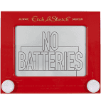
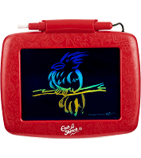
Background Information
Create a PCB for an “Etch-a-Sketch”
Hardware:
SPI Display Screen
Two Potentiometers
Two Buttons (Reset the Game, Change Color)
Three LEDs (Red, Green, and Blue for Color)
USB Port (Expansion)

Slide 3
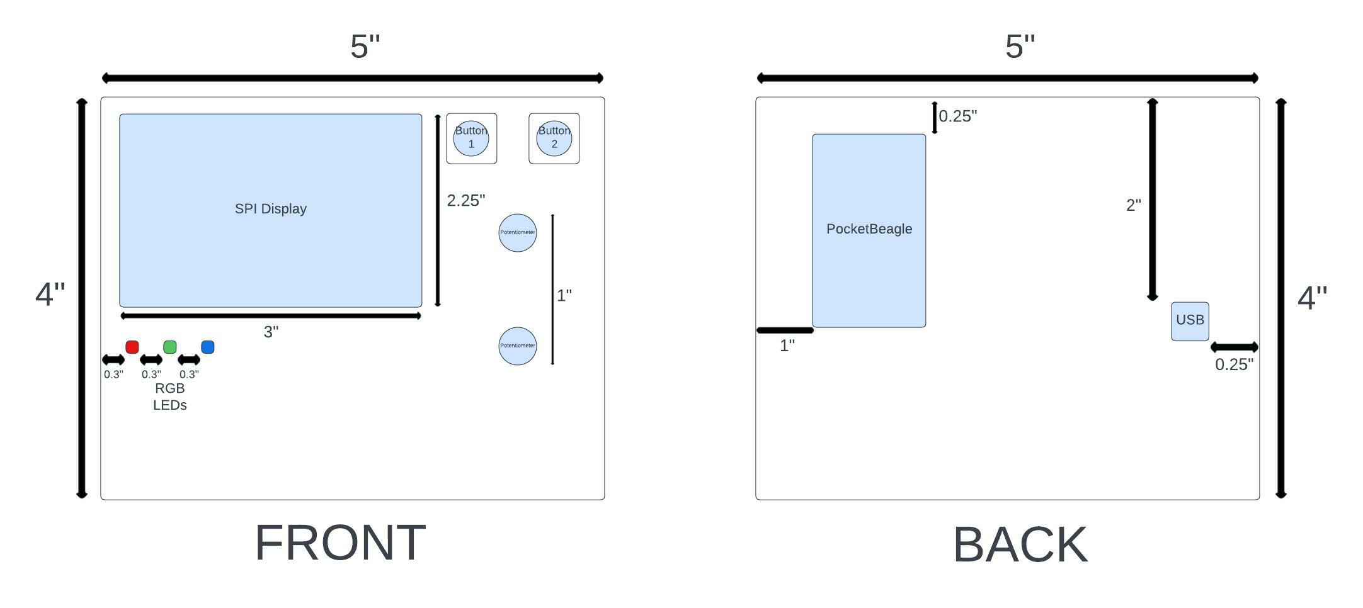
Mechanical Drawing

Slide 4
System Block Diagram – “Etch-a-Sketch”
5V
3.3V
PocketBeagle
VCC
SPI
VCC
USB Host
USB
SPI
SPI
USB
SPI Display
GPIO
GPIO
GPIO
GND
3.3V
GND
GND
1k
1.8V
Potentiometer
3.3V
GPIO
1k
AIN
GPIO
AGND
GPIO
1.8V
Potentiometer
GPIO
AIN
AGND
GPIO

